Slide 1
Humanomics: A Moral Science of Economics
Bart J. Wilson
Smith Institute for Political Economy and Philosophy & Economic Science Institute, Chapman University
Rasmuson Chair in Economics, University of Alaska Anchorage

Slide 2
Poll
The human condition on the third rock from the sun is
getting exponentially worse.
getting worse.
stagnant.
getting better.
getting exponentially better.

Slide 3
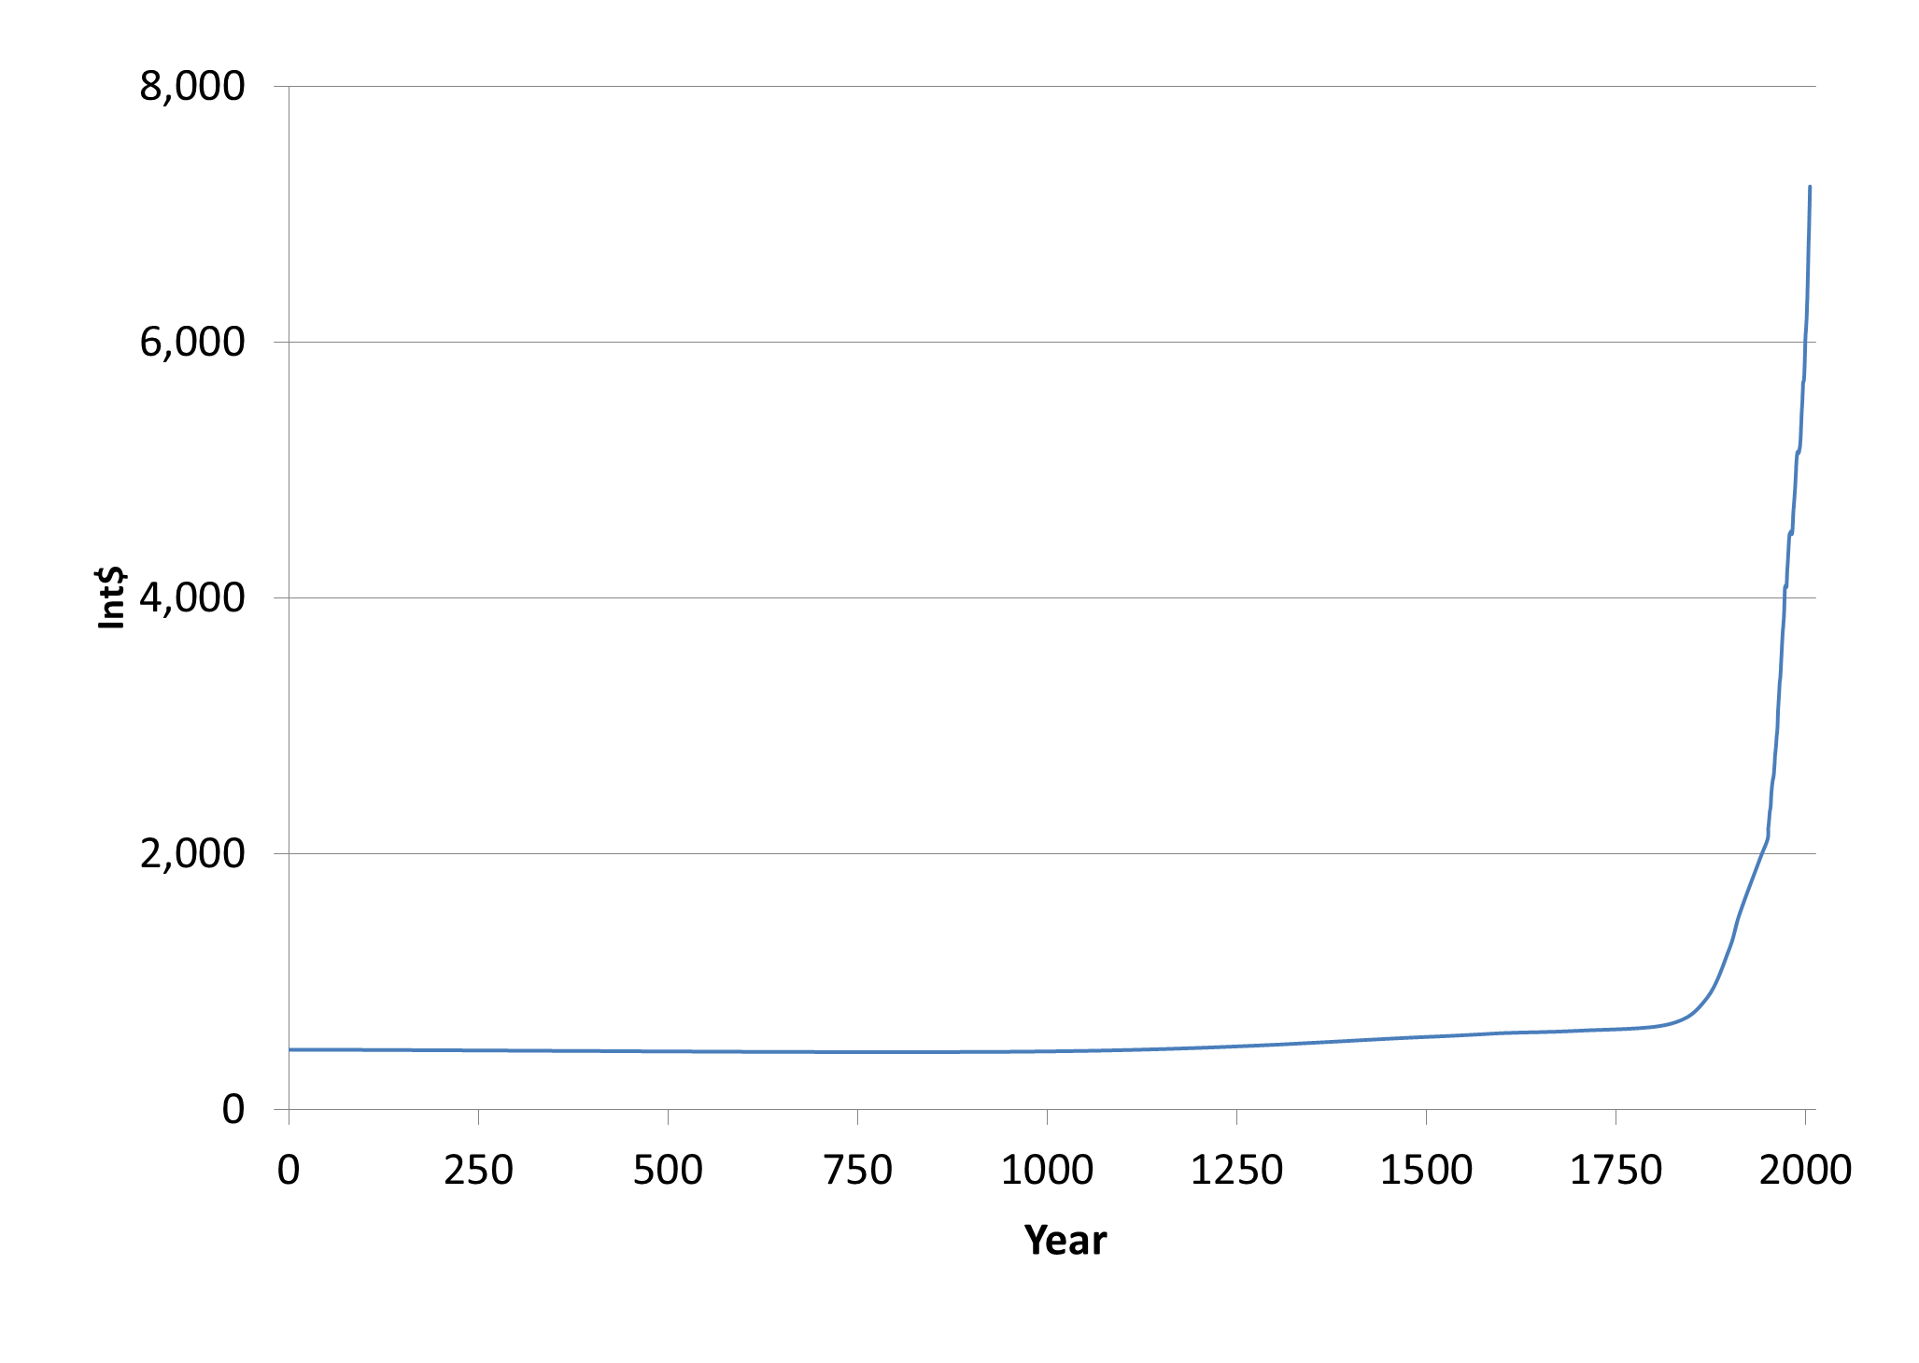

Slide 4
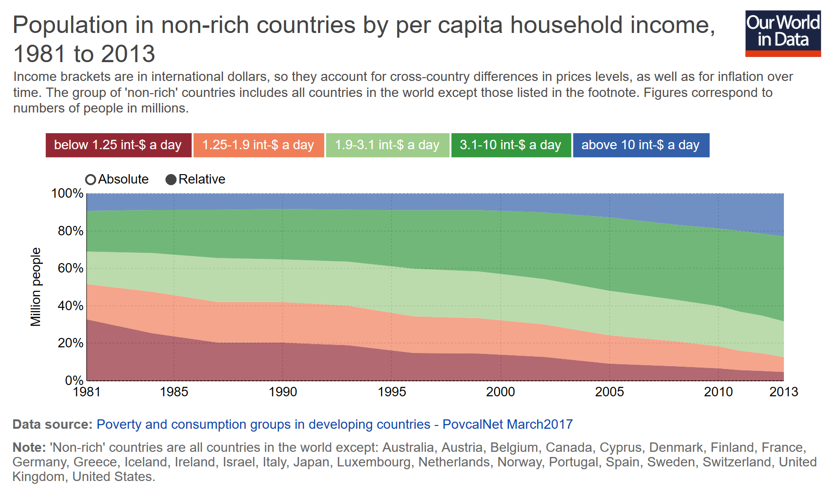

Slide 5
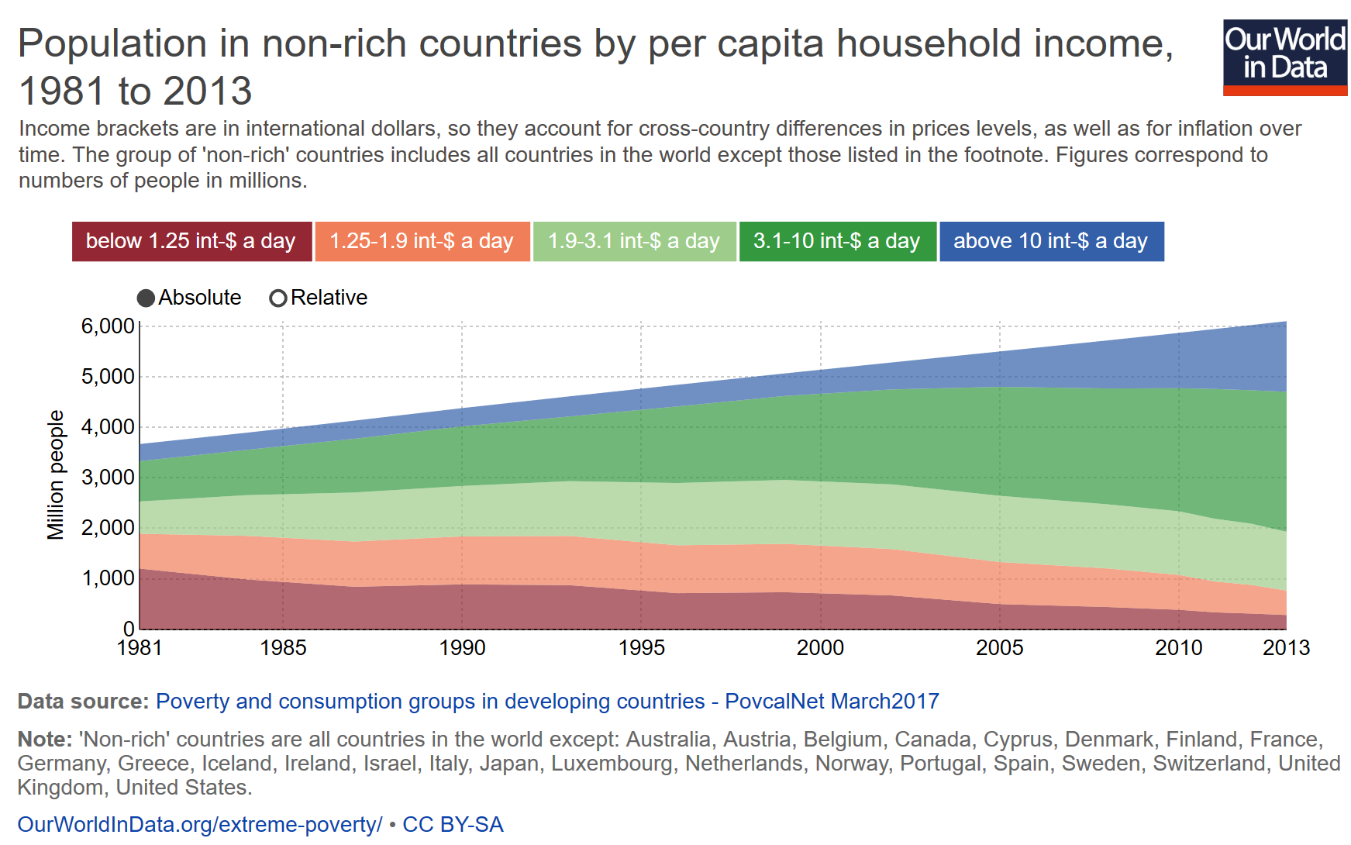

Slide 6
Inquiry begins with two questions:
What makes a rich nation rich?
Economics: Trade
What makes a good person good?
Economics: Who cares?
Humanomics:
What do these questions have to do with one another?
Wealth of Nations + The Theory of Moral Sentiments

Slide 7
I claim in what follows that neither left nor right, neither the Department of English nor the country club—nor the center, eyeless in Starbucks, uneasily ruminating on morsels taken from both sides—is seeing bourgeois life whole.
~Deirdre N. McCloskey, The Bourgeois Virtues

Slide 8
Commerce Unbound: A Modern Promethean Story
Jan Osborn, Bart J. Wilson, and Gus P. Gradinger

Slide 9
Our story is. . .
“a literary-critical economic nonfiction”
LITERARY: an interpretation of Percy Bysshe Shelley’s Prometheus Unbound, a Lyrical Drama in Four Acts (1820)
ECONOMIC: a mapping of the drama onto modern commerce, onto modern concepts of bourgeois life

Slide 10
As Shelley revivified the Promethean story
from a Greek tragedy to a Romantic lyrical drama,
- to provoke change in the way we view
our world
- to“familiarize [readers] with beautiful idealisms
of moral excellence,”
we attempt to revivify the Promethean story in the
21st Century
- to familiarize our readers “with beautiful
idealisms of moral excellence” in their everyday
lives of commerce.

Slide 11
Prometheus Unbound: An Interpretation
Act I
Humans are suffering, living with fear and self-contempt
and barren hope.
Prometheus, their benefactor, has been chained to the rock for 3,000 years, punished for giving gifts to mortals:
He gave man speech, and speech created thought
Which is the measure of the universe.
Prometheus also gave wisdom and strength to Jupiter,
helping him defeat Saturn, with one stipulation,
Let man be free.

Slide 12
And here is Shelley’s insight . . .
In defying the tyrant,
Prometheus perpetuates his own pain
but also Jupiter’s power. He cries out,
No change, no pause, no hope!
In Shelley’s drama, humankind, represented by Prometheus, empowers a hateful god with its own hate.

Slide 13
Prometheus calls out for his love at the end of
Act I:
Most vain all hope but love;
and thou art far, Asia
Shelley’s solution to the degradation of humankind
is a correspondence, a community with others, a
uniting of those in exile, a love that
begins and ends in thee

Slide 14
We will take our plan
From the new world of man,
And our work shall be called Promethean.
~Prometheus Unbound (Act IV, l. 156 – 158)

Slide 15
. . . for the humbled authors
Of this not so humble piece,
The marketplace and daily interaction,
Our Commerce is the instrument of choice;
Love, its tuner, perfecting its sound.
Here is where we find hope unbound.
Disagreements inevitable, conflict inescapable,
But fellow feeling and virtue omnipresent.
Lead not with curses, but with hearts;
Allow the mind to love and admire,
To trust, hope, and endure.

Slide 16
Shelley’s our agent
Painting us in brighter light.
Not naïve, but hopeful (we hope).
Understanding humanity as a process,
And as a goal.
Exchange goods and goodness exchange;
Let love be our Hercules,
Our work Promethean.
Oh, could it be, even,
McCloskeyan?

Slide 17
The arts illustrate the form of the world that man is trying to create out of the world he is in.
~ Northrup Fry
A Study of English Romanticism
Economics is the science which studies human behavior as a relationship between given ends and scarce means which have alternative uses.
~ Lionel Robbins

Slide 18
The arts illustrate the form of the world that man is trying to create out of the world he is in.
~ Northrup Fry
A Study of English Romanticism
It is not enlightening to be told that conduct consists in choosing between possible alternatives.
~ Frank Knight

Slide 19
The arts illustrate the form of the world that man is trying to create out of the world he is in.
~ Northrup Fry
A Study of English Romanticism
Economics…must be [a branch] of literature as much as of science. In fact [it] need[s] to be both, and commonly succeed[s] in being neither.
~ Frank Knight

Slide 20
The arts illustrate the form of the world that man is trying to create out of the world he is in.
~ Northrup Fry
A Study of English Romanticism
Humanomics also illustrates. . .
the form of the world that humankind is trying to create out of the world it is in.

Slide 21
The arts illustrate the form of the world that man is trying to create out of the world he is in.
~ Northrup Fry
A Study of English Romanticism
Humanomics Economics illustrates. . .
the form of the world that humankind is trying to create out of the world it is in.

Slide 22
Humanomics: A Moral Science of Economics Economics is a Moral Science
Bart J. Wilson
Smith Institute for Political Economy and Philosophy & Economic Science Institute, Chapman University
Rasmuson Chair in Economics, University of Alaska Anchorage

Slide 23
Thank you

