Slide 1

How to create growth: The benefit of economic freedom to citizens in Europe and around the world
Prof. Edward Peter Stringham
Hackley Distinguished Professor for the
Study of Capitalism and Free Enterprise
Fayetteville State University
North Carolina, United States

Slide 2
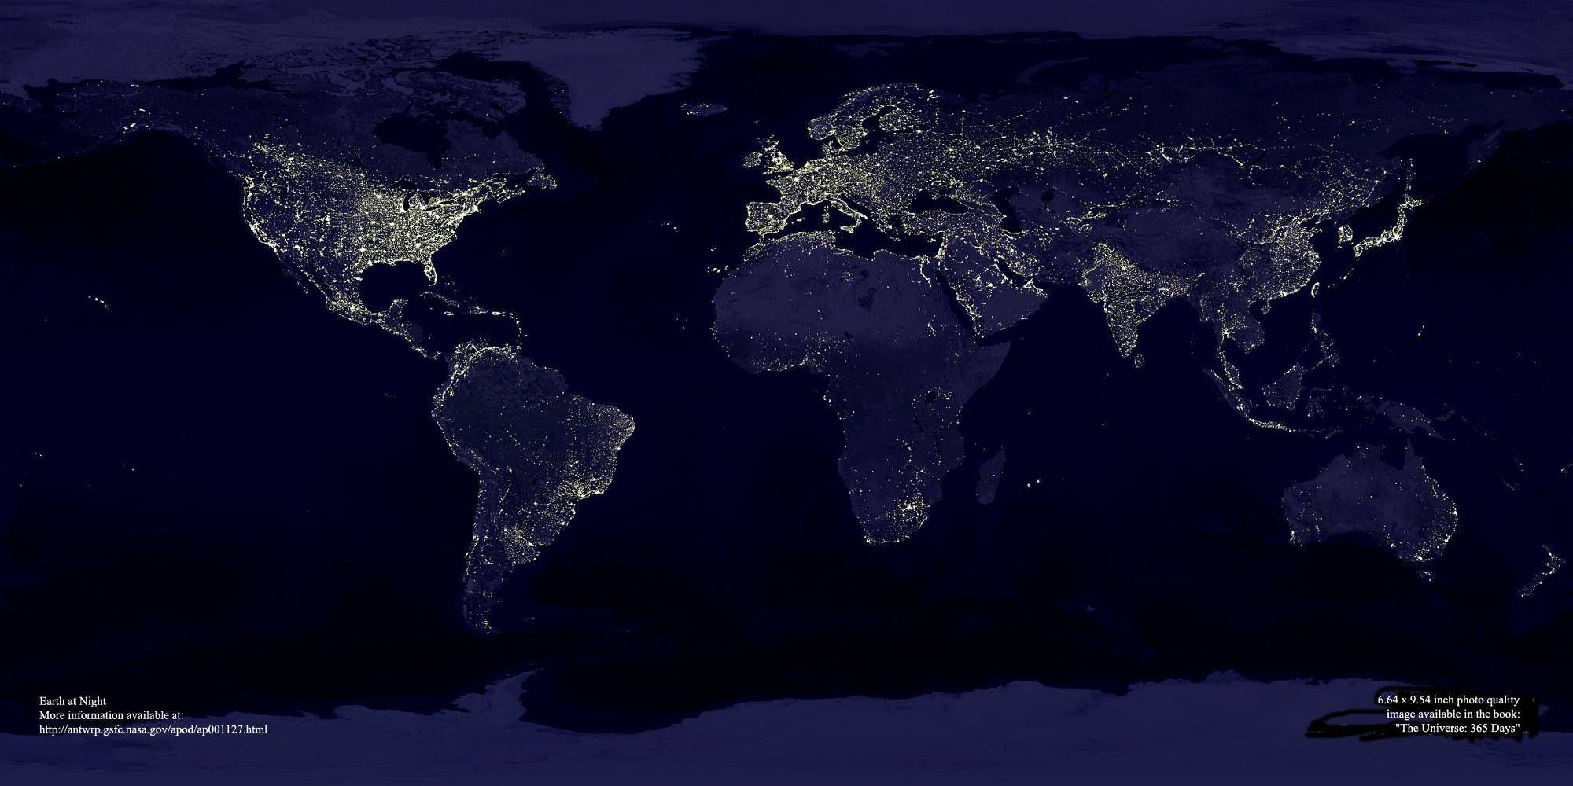
What Explains Growth?
Is it Resources? Location? Democracy? Or ……

Slide 3
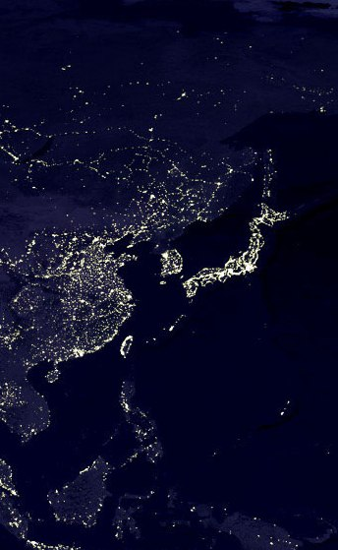
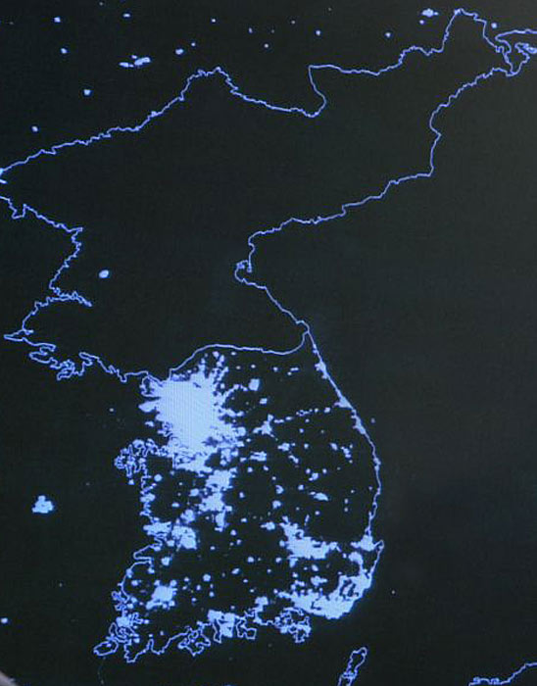
North Korea vs. South Korea
Per Capita Income
= $1,800
Per Capita Income
= $24,200

Slide 4
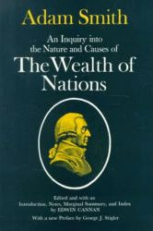
Adam Smith’s Question:
Why Are Some Countries Rich and Others Poor?
An Inquiry into the Nature and Causes of the Wealth of Nations (1776)
Policies and the system of economic organization (e.g., capitalism) matter more than things such as resources, geography, education, democracy, etc.

Slide 5
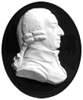
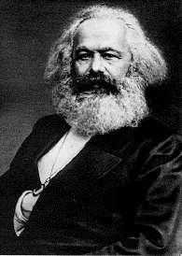
The Great Debate: Smith v. Marx
Adam Smith (1723-1790)
Advocated a system of “natural liberty”: individual pursuit of self interest in markets (not selfishness), free trade and limited government involvement.
Karl Marx (1818-1883)
Advocated socialism/communism: collective/govenment ownership/control of resources, central planning.

Slide 6
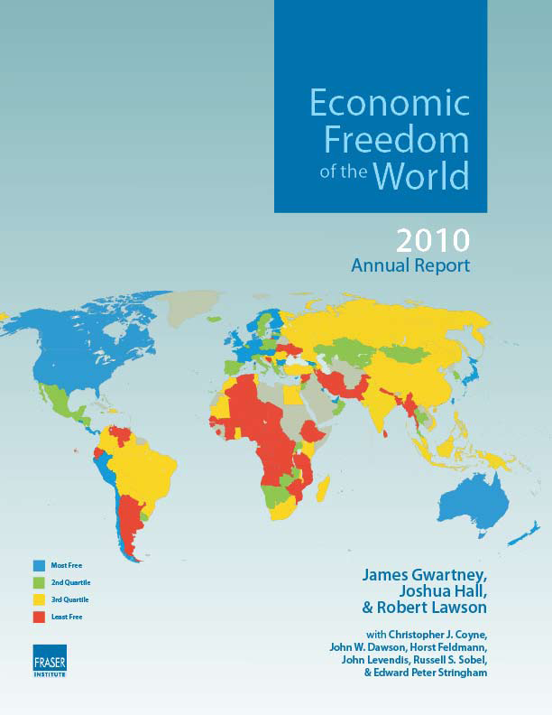

Slide 7
Economic Freedom
Economic Freedom means that people are free to trade with others, compete in markets, buy what they want, earn a living in a job they choose, keep what they earn, and own things privately.

Slide 8
Measuring Economic Freedom
Economic freedom is complex and multidimensional, but it can be measured:
  Personal choice
  Freedom to trade, domestically and abroad.
  Freedom to enter and compete in markets.
  Security of Property/Rule of Law

Slide 9
Negative v. Positive Rights
Negative “freedom from” rights.
  Individuals may all simultaneously enjoy such rights.
  No individual owes anyone else anything except the promise not to interfere with him/her.
  John Locke and others
Positive “freedom to do or have” rights.
  Individuals may not all simultaneously enjoy such rights as such rights imply a claim by one person on the time and talents of another.
  Amartya Sen’s Freedom as Development

Slide 10
Alternative Views of EF
No country perfectly conforms to the free-market ideal—all economies are mixed economies.
  Rothbard → Friedman → Keynes → Marx
“Institutional Quality” or “Social Capital”
  Barro, Hall and Jones.

Slide 11
Is Economic Freedom a good?
We want to measure EF for the same reason we want to measure GDP: Freedom is a good. People appear to want more of it, ceteris paribus.
However, like the production of all goods, there are tradeoffs.
  Achieving more EF may mean the sacrifice of other social goals (e.g., equality)
The index is designed to measure EF. It does not, and cannot, determine the optimal level of freedom. This is a value judgment.
  Still, having the index will help us evaluate those tradeoffs.

Slide 12
Motivation
The key to changing policy in the world is changing the climate of opinion about what works and what does not work in encouraging world development
The key to changing the climate of opinion is providing the widest possible audience with good information about the causes of development and under-development

Slide 13
Economic Freedom of the World Project
Objective: find a way to measure economic freedom and explore the connection between it and other indicators
20 year project
Led by the late Milton Friedman, Rose Friedman and Michael Walker
Involved 60 of the world’s top scholars, including three Nobel Laureates: Milton Friedman, Douglass North, and Gary Becker

Slide 14
What is the Economic Freedom of the World Index?
An annual compilation of data representing factors which make a country economically free
Authors: James Gwartney, Robert Lawson, and Walter Block
A compendium of 42 government policies affecting economic freedom based on objective data or independent surveys
A ranking of 141 countries representing 95% of the world’s population according to the extent to which they permit their citizens to be economically free
Now a collaboration of Institutes in 76 different nations and territories

Slide 15
Components of the Economic Freedom of the World Index
Size of government and taxation
Private property and the rule of law
Soundness of money
Trade regulation and tariffs
Regulation of business, labour and capital markets

Slide 16
5 Areas of Economic Freedom of the World (EFW) Index
Size of Government: Expenditures, Taxes, and Enterprises
Legal Structure and Security of Property Rights
Access to Sound Money
Freedom to Trade Internationally
Regulation of Credit, Labor, and Business

Slide 17
Area 1: Size of Government
Government Consumption (% of C)
  E.g., France’s G/(G+C) = 29.9%
  (Vmax-Vi)/(Vmax-Vmin)*10
  (40-29.9)/(40-6)*10 = 3.0
B. Transfers & Subsidies (% of GDP)
C. Government Investment (% of I) & Government Enterprises
D. Marginal Tax Rates (top rate & threshold-2 sub-components)

Slide 18
Area 2: Legal Structure and Security of Property Rights
A. Judicial Independence (GCR)
B. Impartial Courts (GCR)
C. Protection of Intellectual Property (GCR)
D. Military Interference (ICRG)
E. Integrity of Legal System (ICRG)

Slide 19
Area 3: Access to Sound Money
A. Money Growth (minus economic growth)
B. Inflation Variability (st. dev. of inflation)
C. Inflation Rate (recent annual rate)
D. Freedom to Own Foreign Currency Bank Accounts Domestically and Abroad

Slide 20
Area 4: Freedom to Exchange with Foreigners
A. Taxes on International Trade (3 sub-components)
B. Regulatory Trade Barriers (2 sub-components)
C. Trade Sector Size (actual compared with expected)
D. Black Market Exchange Rates
E. Capital Market Controls (2 sub-components)

Slide 21
Area 5: Regulation
A. Credit Market Regulations (5 sub-components)
B. Labor Market Regulations (5 sub-components)
C. Business Regulations (5 sub-components)

Slide 22
A Quick Tour of The World
Photos are compiled by Russel Sobel, Ph.D.

Slide 23
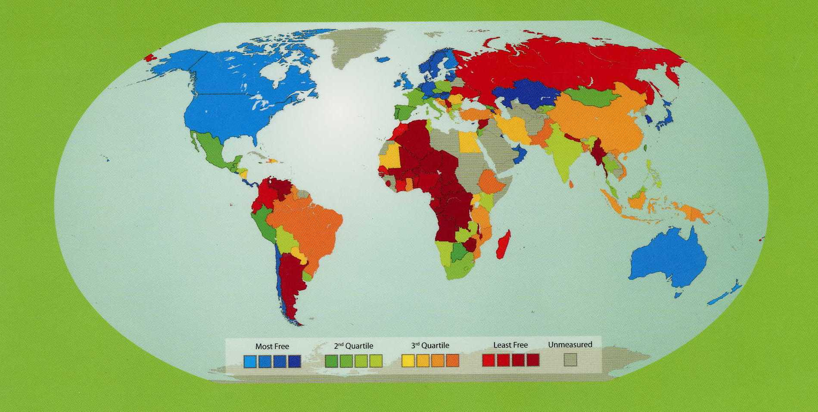

Slide 24
Example 1
A country with VERY LOW economic freedom

Slide 25
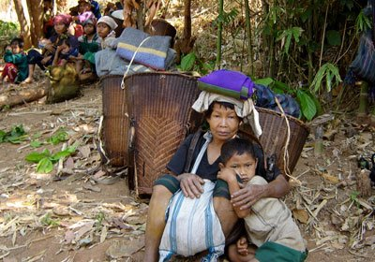
Families in Guinea-Myanmar

Slide 26
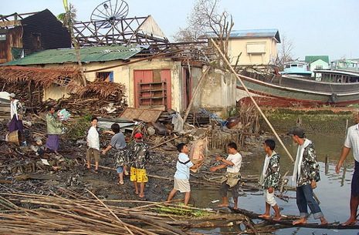
Relief efforts in Guinea-Myanmar

Slide 27
Example 2
A country with LOW economic freedom

Slide 28
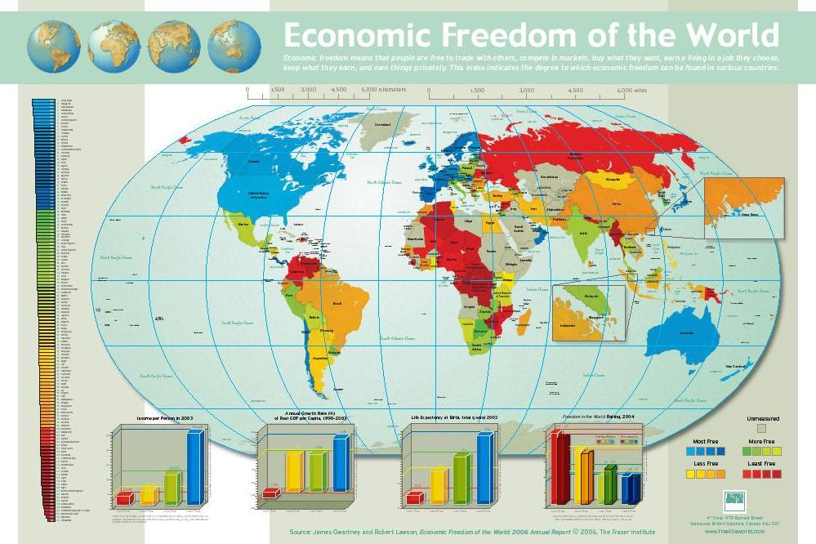
Romania

Slide 29
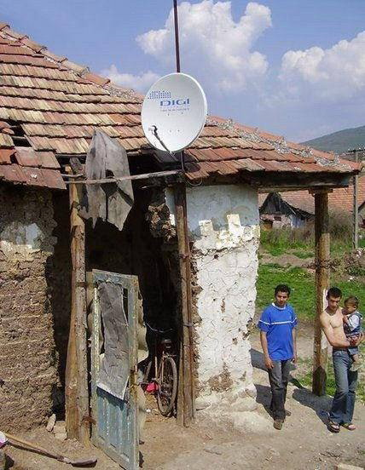
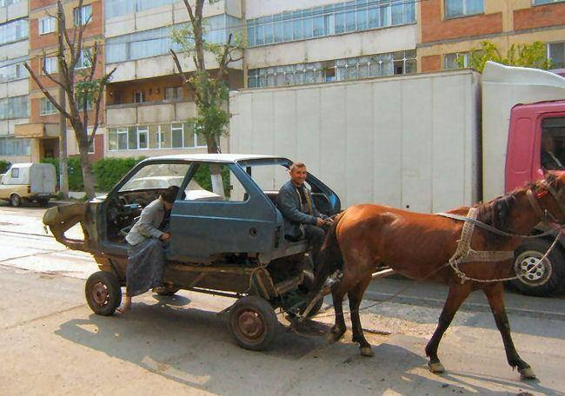
Families in Romania

Slide 30
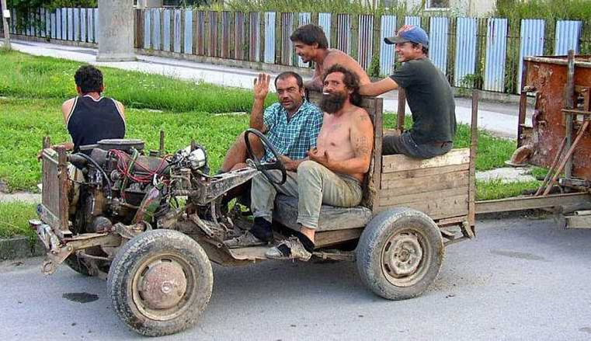
Families in Romania

Slide 31
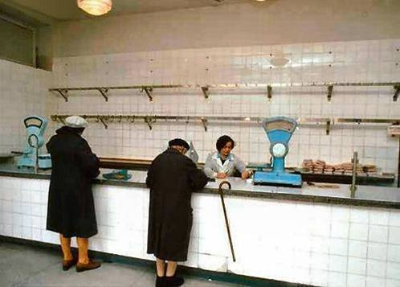
Families in Romania

Slide 32
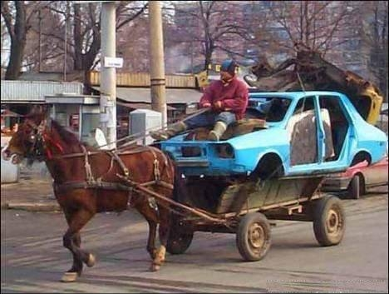
Families in Romania

Slide 33
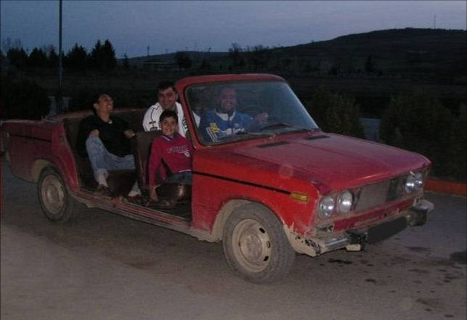
Families in Romania

Slide 34
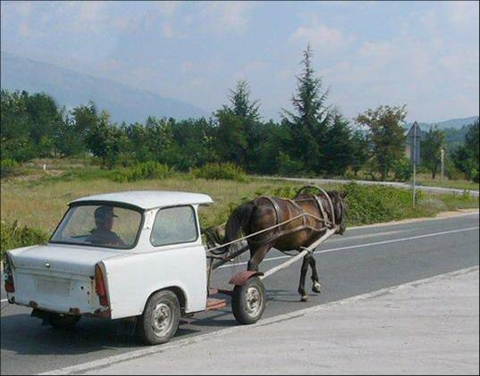
Families in Romania

Slide 35
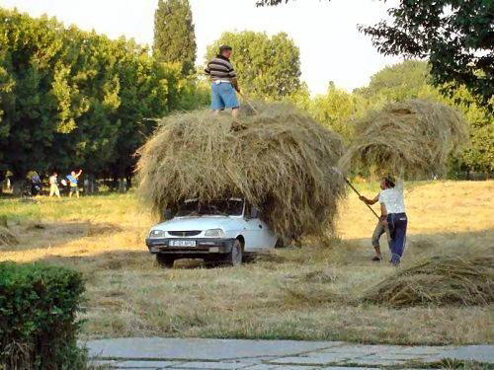
Families in Romania

Slide 36
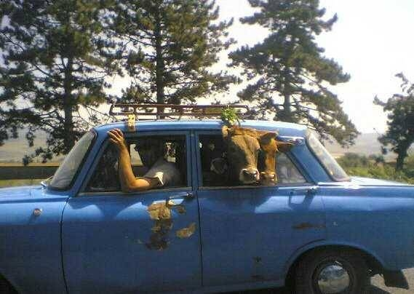
Families in Romania

Slide 37
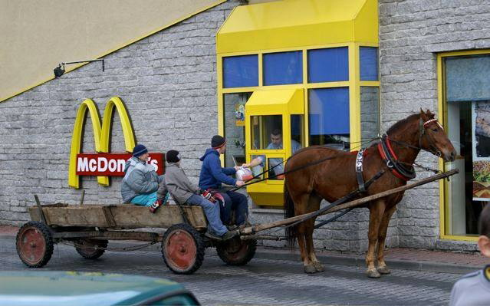
Families in Romania

Slide 38
Example 3
A Country with MEDIUM Economic Freedom

Slide 39
India

Slide 40
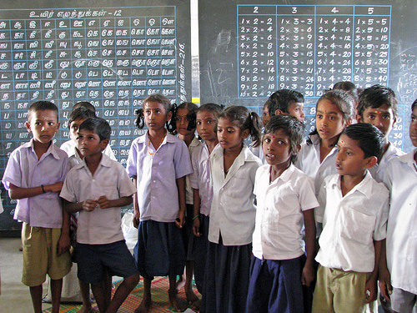
Families in India

Slide 41
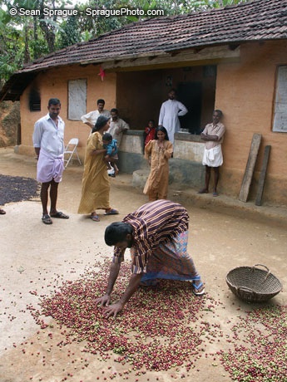
Families in India

Slide 42
Example 4
Another Country with Medium Economic Freedom

Slide 43
Mexico

Slide 44
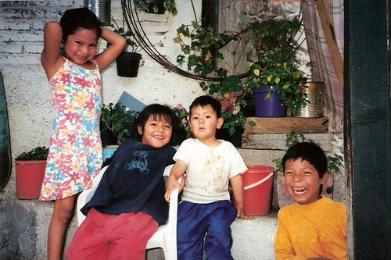
Families in Mexico

Slide 45
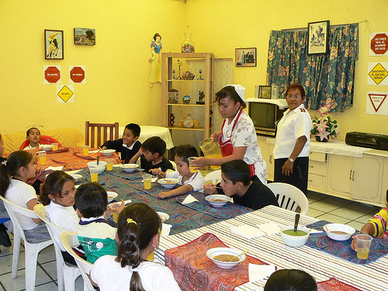
Families in Mexico

Slide 46
Example 5
A Country with HIGH Economic Freedom

Slide 47
Hong Kong

Slide 48
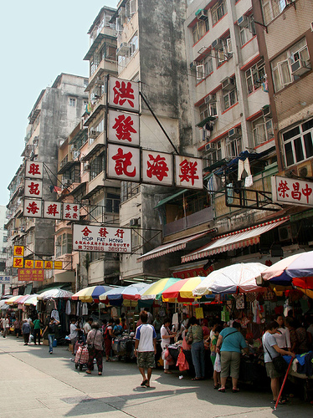
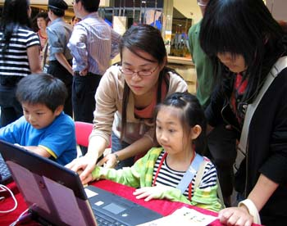
Families in Hong Kong

Slide 49
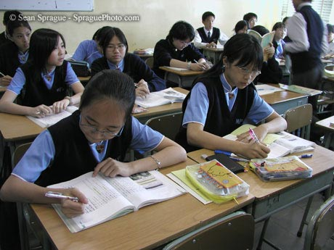
Families in Hong Kong

Slide 50
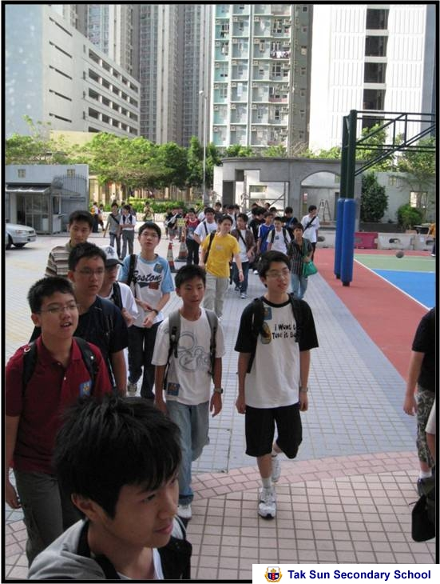
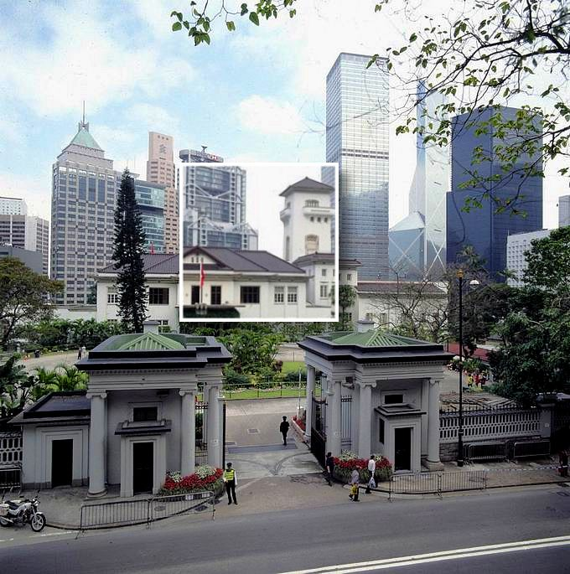
Families in Hong Kong

Slide 51
Overall Economic Freedom Index and the Top 10
Source: The Fraser Institute.

Slide 52
Overall Economic Freedom Index and the Bottom Ten
Source: The Fraser Institute.

Slide 53
Why is Economic Freedom Important?
Economic rights are fundamental rights in the sense that without them there can be no political or civil freedoms
They are a prerequisite for growth and development
They are a prerequisite for broader human development

Slide 54
The impact on economic growth and development

Slide 55
Income (per person) of the Bottom Ten
Sources: The Fraser Institute; The World Bank, World Development Indicators, 2008.

Slide 56
Income (per person) of the Top 10
Sources: The Fraser Institute; The World Bank, World Development Indicators, 2008.

Slide 57
Per Capita Income and Economic Freedom Quartile
Least Free ………………... Most Free
Sources: The Fraser Institute; The World Bank, World Development Indicators, 2008.

Slide 58
Foreign Direct Investment and Economic Freedom Quartile
Least Free ……………...…... Most Free
Sources: The Fraser Institute; The World Bank, World Development Indicators, 2008.

Slide 59
Economic freedom and economic growth have bestowed benefits across all levels of society

Slide 60
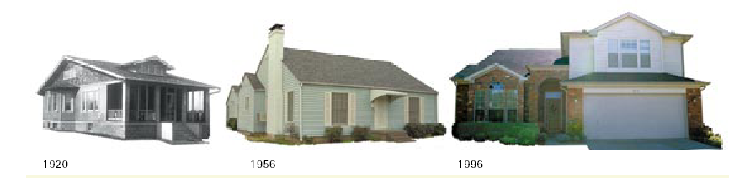
Our Homes
Percent of homes with Heating & Air Conditioning
  1956 = 6% 1996 = 81%
Percent of homes with only one bathroom
1956 = 71% 1996 = 9%

Slide 61
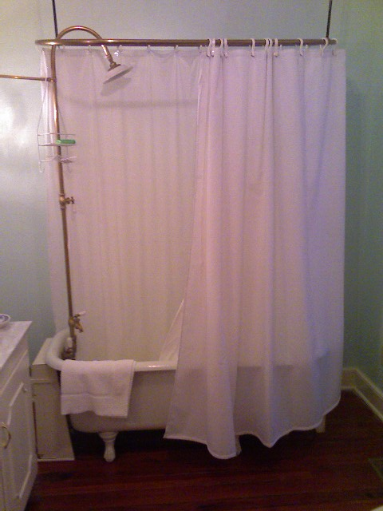
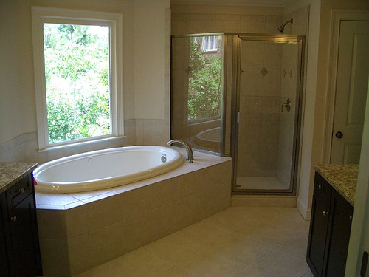
And They are Better: Our Showers

Slide 62
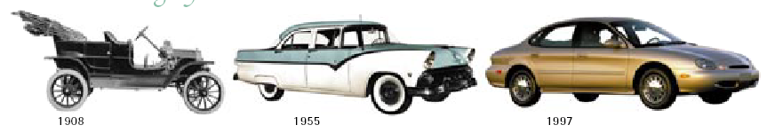
Our Cars
We now have DVD players, Air Conditioning, Anti-lock Brakes, Power windows

Slide 63
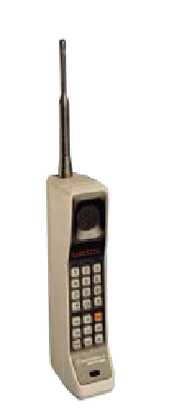

Our Phones

Slide 64
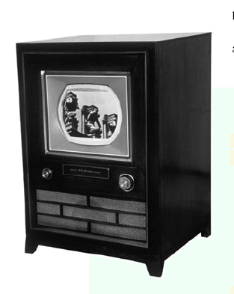
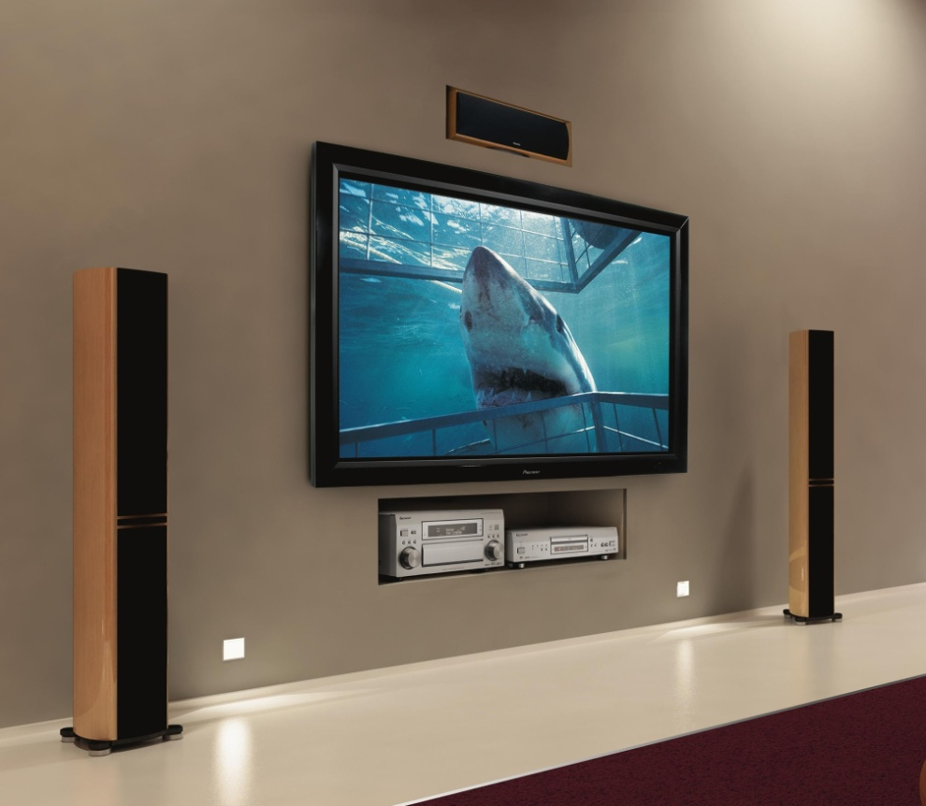
Our Entertainment

Slide 65
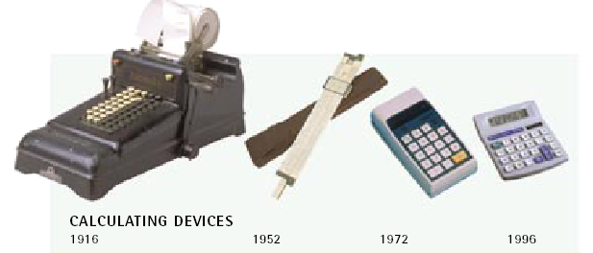
Our Science

Slide 66
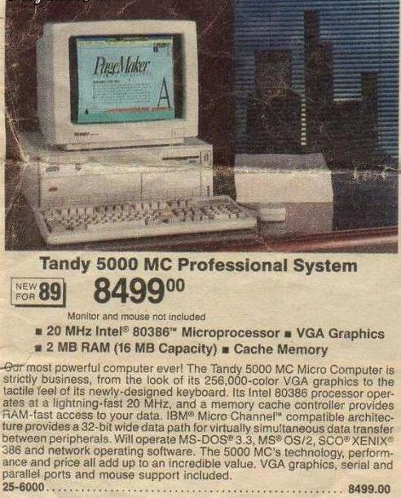

Our Computers

Slide 67
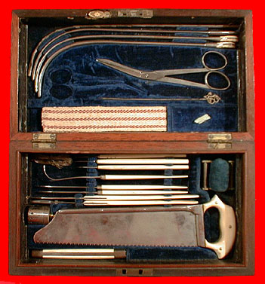
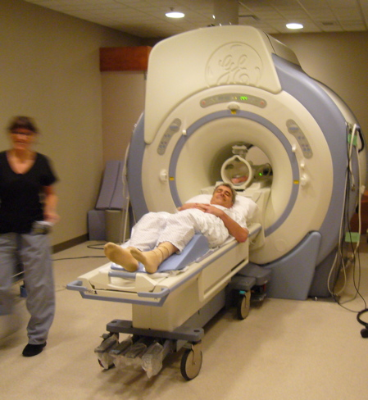
Our Medicine

Slide 68
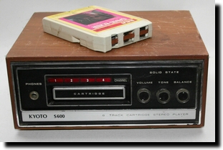
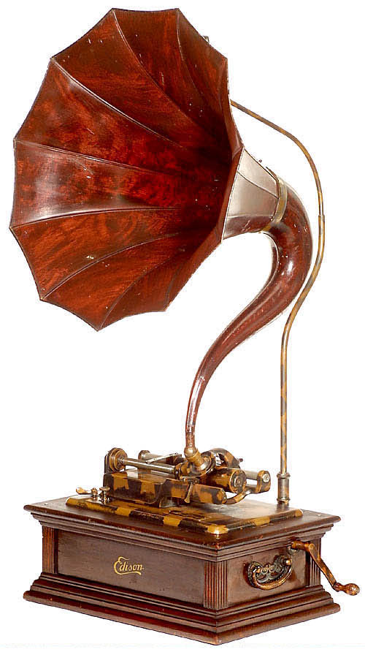
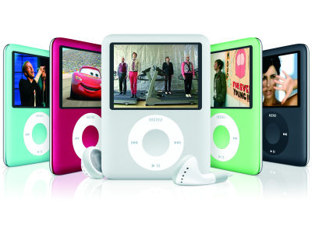
Our Music

Slide 69
But what about the poor?

Slide 70
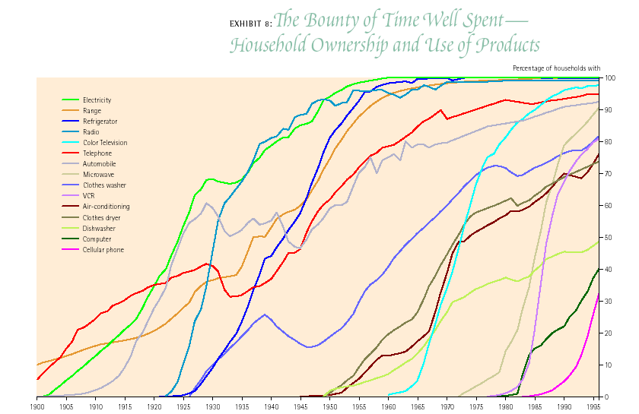

Slide 71
Economic Freedom,the Poor, and
Inequality

Slide 72
Income Share of the Poorest 10% and Economic Freedom
Least Free …………….. Most Free
Sources: The Fraser Institute; The World Bank, World Development Indicators, 2008.

Slide 73
Income Level of the Poorest 10% and Economic Freedom
Least Free …………….. Most Free
Sources: The Fraser Institute; The World Bank, World Development Indicators, 2008.

Slide 74
A free society also has no barriers to getting rich
University of Michigan Panel Survey on Income Dynamics data show that of Americans in the bottom 20 percent income bracket in 1975, only 5.1 percent of them remained in that lowest income bracket by 1991.
In fact, 29 percent of the lowest fifth of income earners in 1975 had moved to the top 20 percent of income earners in 1991.

Slide 75
The impact of Economic Freedom on the UN’s Human Development Index and other indicators of well-being

Slide 76
Human Development Index and Economic Freedom Quartiles
Higher ratings indicate higher levels of development
Least Free ……………. Most Free
Sources: The Fraser Institute; United Nations Development Programmme, Human Development Indicators 2008, available at http://hdr.undp.org/.

Slide 77
Life Expectancy at Birth and Economic Freedom Quartiles
Least Free ……………. Most Free
Sources: The Fraser Institute; The World Bank, World Development Indicators, 2008.

Slide 78
Infant Mortality and Economic Freedom Quartile
Least Free ………..………. Most Free
Sources: The Fraser Institute; The World Bank, World Development Indicators, 2008.

Slide 79
% of Population Using Improved Water Sources
Least Free ………………... Most Free
Sources: The Fraser Institute; The World Bank, World Development Indicators, 2008.

Slide 80
Environmental Performance and Economic Freedom Quartile
Higher ratings indicate higher levels of environmental performance
Least Free ………..……….. Most Free
Sources: The Fraser Institute; The World Bank, World Development Indicators, 2008.

Slide 81
Can a nation improve their level of economic freedom?

Slide 82
Economic Freedom Over Time
Source: The Fraser Institute.

Slide 83
Case Study: Zimbabwe
Legal Structure/Property Rights rating has fallen to 3.7 from 5.5.
Annual inflation has increased to 349% from 6.5%.
Foreign currency bank accounts are illegal.
Tariff rates increased to 16.7% from 8.7%.
Price control rating = 0.0!
GDP per capita growth, 1995-2005 = -3.43%

Slide 84
Case Study: Venezuela
Government consumption increased to 20.3% from 14.4%.
Transfers & subsidies increased to 15% from 2%.
Inflation remains high at 16%.
Foreign currency accounts restricted.
Military interference rating fallen to 0.8 from 5.6.
GDP per capita growth, 1995-2005 = -0.36%

Slide 85
Case Study: Ireland
Transfers & Subsidies fell to 11.7% from 21.8%.
Top marginal tax rates fell to 42% from 65%.
Tariff rate fell to 2.7% from 8.8 %.
Sound Money rating increased to 9.7 from 5.8.
GDP per capita growth, 1995-2005 = 5.97%

Slide 86
Case Study: Estonia
Transfers & Subsidies fell to 11.7% from 15.3%.
Inflation fell to 1.6% from 33.7%.
Credit market regulation rating increased to 9.7 from 4.3.
Legal Structure/Property Rights rating increased to 7.7 from 6.5.
GDP per capita growth, 1995-2005 = 7.27%

Slide 87
Case Study: Chile
Top marginal tax rates fell to 40% from 58%.
Tariff rate fell to 4.9% from 30%.
Inflation rate fell to 3.1% from 30.7%.
Capital market controls lifted.
GDP per capita growth, 1995-2005 = 2.99%

Slide 88
Case Study: China
Freer trade: tariffs reduced to 9.2% from 49.5%.
Capital market deregulation: rating improved to 6.5 from 0.0.
Note: China varies tremendously internally.
GDP per capita growth, 1995-2005 = 8.21%

Slide 89
Case Study: India
Government investment and SOEs are less important: The rating in this area increased to 8 from 0.
Tariffs have fallen to 17%. from 98.8%
Many capital market controls have been lifted.
GDP per capita growth, 1995-2005 = 4.68%

Slide 90
Case Study: Botswana
Improved monetary stability: 5.3 to 9.0 rating.
Fewer regulations: 5.9 to 7.6 rating.
Improved legal structure rating: 6.3 to 7.4 rating.
GDP per capita growth, 1995-2005 = 6.14%

Slide 91
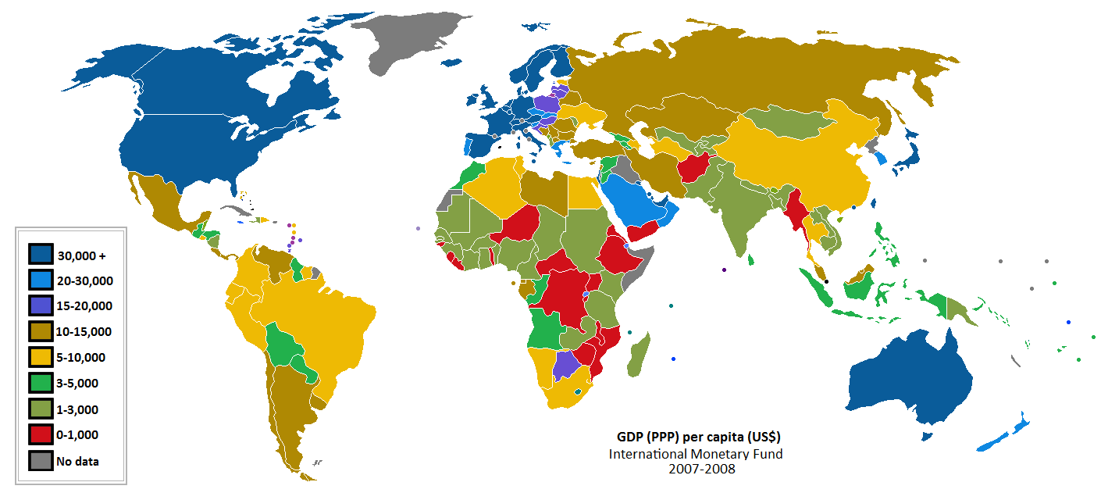
GDP per capita by country

Slide 92
Economic Freedom by Country

Slide 93
Conclusions
Economic Freedom is associated with
Lower rates of homicide
Reduced poverty
Increased prosperity for rich and poor

Slide 94
How to create growth: The benefit of economic freedom to citizens in Europe and around the world
Prof. Edward Peter Stringham
Lloyd Hackley Endowed Professor of Capitalism and Free Enterprise Studies
Fayetteville State University

Slide 95
Latest research
Economic freedom and crime

Slide 96
The Encyclopedia of Murder and Violent Crime states, “Killing and violent behavior has permeated the development of America,” attributing this in large part to “the inevitable clash of capitalism” (Hickey, 2003, pp.xxxi-xxxii).
“The only source of crime is capitalism” (Lynch and Groves, 2000, p.336).

Slide 97
Crime and Capitalism (Greenberg, 1993) contains thirty chapters arguing how markets cause crime.
Wenger and Bonomo (1993, p.420) “[T]he relationship between crime and the terminal crisis of capitalism has become the subject of considerable debate….[But] the debate does not concern the role of capitalism in producing crime—to all but the reactionary or the naïve, such questions have long been settled.”

Slide 98
(homicide rate) = β₁
+ β₂(economic freedom)
+ β₃(incarceration rate)
+ β₄(death penalty)
+ β₅(gini)
+ β₆ (literacy rate)
+ ε,

Slide 101
Figure 1: Partial Regression Plot for Regression 1 (dependent variable: homicide rate) with Economic Freedom data from Fraser (higher scores indicate more economic freedom)

Slide 102
Case studies

Slide 108
Moving forward

Slide 109
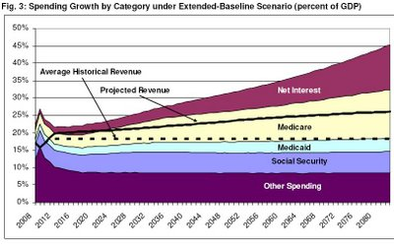

Slide 110
Economic Freedom of the World
www.freetheworld.com

Slide 111
Economic Freedom of the World
www.freetheworld.com

Slide 112
The Importance of Economic Freedom
Prof. Edward Peter Stringham
Lloyd Hackley Endowed Professor of Capitalism and Free Enterprise Studies
Fayetteville State University

